Slide 1

Green Pace
Security Policy Presentation
Developer: Angelica Hayes

Slide 2

OVERVIEW: DEFENSE IN DEPTH
The Defense in Depth policy for Green Pace outlines and defines the Ten Core Security Principles. It will also outline C/C++ Coding standards on pages 5-27. Each outline includes examples of noncompliant code versus compliant code with detailed threat level assessments and tools to automate the standards.

Slide 3
THREATS MATRIX
Likely STD-002-CPP(CTR58-CPP) STD-003-CPP(STR52-CPP) STD-004-CPP(IDS00-J) STD-005-CPP(MEM52-CPP) STD-006-CPP(CTR54-CPP) STD-007-CPP(DCL57-CPP) STD-008-CPP(OOP51-CPP) STD-009-CPP(CTR52-CPP) | Priority STD-005-CPP(MEM52-CPP) STD-009-CPP(CTR52-CPP) STD-004-CPP(IDS00-J) STD-006(CTR54-CPP)
Low priority STD-001-CPP(EXP59-CPP) STD-002-CPP(CTR58-CPP) STD-003-CPP(STR52-CPP) STD-007-CPP(DCL57-CPP) STD-008-CPP(OOP51-CPP) STD-010-CPP(FIO51-CPP) | Unlikely STD-001-CPP(EXP59-CPP) STD-010-CPP(FIO51-CPP)

Slide 4
10 PRINCIPLES
Validate Input Data
Heed Compiler Warnings
Architect and Design for Security Policies
Keep It Simple
Default Deny
Adhere to the Principle of Least Privilege
Sanitize Data Sent to Other Systems
Practice Defense in Depth
Use Effective Quality Assurance Techniques
Adopt a Secure Coding Standard

Slide 5
CODING STANDARDS
Data Type : STD-001-CPP(EXP59-CPP)
Data Value : STD-002-CPP(CTR58-CPP)
String Correctness: STD-003-CPP(STR52-CPP)
SQL Injection : STD-004-CPP(IDS00-J)
Memory Protection : STD-005-CPP(MEM52-CPP
Assertions : STD-006-CPP(CTR54-CPP)
Exceptions : STD-007-CPP(DCL57-CPP)
Object Oriented Programming: STD -008-CPP (OOP51-CPP)
Prevent Overflow: STD- 009-CPP(CTR52-CPP)
Input/Output: STD-010-CPP(FIO51-CPP)

Slide 6
ENCRYPTION POLICIES
Encryption in rest: This is designed to prevent anyone attempting to attack the system to access the information directly from a hard drive by ensuring that the data on the drive is encrypted. In order to gain access, they would need to beat the encryption first in order to read the data. This can be important if your physical devices get stolen or misplaced.
Encryption at flight: This is the process of encrypting information that is being transmitted. Sometimes the information may not be encrypted while its at rest but will be encrypted during transmission in order to protect it. This can be a good way of protecting any information from falling into the wrong hands so to speak, though it is considerably more vulnerable than encryption in rest.
Encryption in use: This is the process of ensuring that all the information is always secured and encrypted and never left vulnerable. This is the most secure of the practices and should at best always be used if possible.

Slide 7
TRIPLE-A POLICIES
Authentication: This is generally the first step in a Triple-A framework. It helps to ensure that only those that are supposed to have access are let in. It can also keep a log of what a user does under the credentials that have been authenticated.
Authorization: This is the step that determines what the user is allowed to do in the system. Can they make changes or just read documents? Is there a certain time that they should only ever be logged on? This can be used to ensure that something is not accidentally altered by someone that should not have access to it
Accounting: This keeps track of all the resources used by the users in the system. It can help keep track of things like, the length of their session or what data was sent and received. It can help with billing and keeping track of trends.

Slide 8
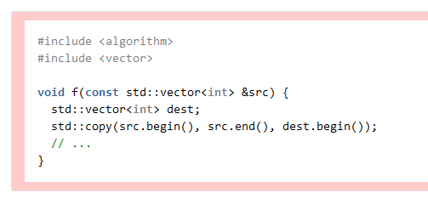
Unit Testing
In this Noncompliant code example, a vector of integers is copied from src to dest using std::copy(). Since std::copy() does nothing to expand the dest vector, the program will overflow the buffer on copying the first element.
The Standard that I chose to is STD-009-CPP. This checks to ensure that we can prevent overflow. STL containers can be subject to the same vulnerabilities as array data types. The “std::copy()” algorithm does not provide any bounds checking and this can lead to a buffer overflow.

Slide 9
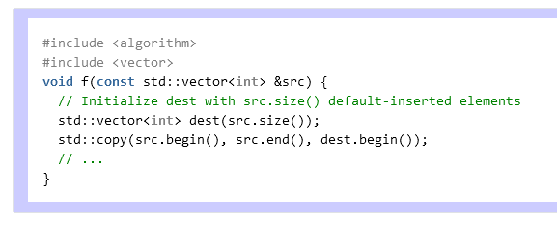
Unit Testing
This Compliant code example shows the proper way to use std::copy(). This is by ensuring the destination container can hold all the elements being copied to it. It enlarges the capacity of the vector prior to the copy operation.

Slide 10

AUTOMATION SUMMARY

Slide 11
TOOLS
The DevOps process for Green Pace can be automated for enforcement at the Transition and Health check phase of the cycle. This is the part of the process where recently verified and tested settings are deployed. The deployment of these security settings can be automated by pushing updates with a set of pre-configured rules and standards to all live systems. This will alleviate human error that can happen from configuring these rules and standards manually. Normally penetration testing is done manually; however, a penetration testing lab could be automated to constantly test the newly released settings. If this automated system can gain unauthorized access to the new code, it will trigger an event immediately. Finally, the system would begin by closing necessary ports, blocking IPs, and turning off services as needed. At this point, the response team would be able to monitor and stabilize the system.

Slide 12
RISKS AND BENEFITS
Act Now or Wait – Waiting could open Green Pace to increased risk from different threat agents. Should a breach occur the cost to Green Pace would be far higher than the price to implement the policy now.
Strategy Shortcomings – With all security policies there are some shortcomings. Complexity can be a double edged sword for security. Normally, complexity would make it harder for someone to gain access; however, the increased complexity of the policy can create its own vulnerabilities
What to do? – Implementing this policy could certainly break existing code bases of Green Pace. All data should be securely backed up prior to any changes to the code base. While the policy is being implemented ensure to test at regular intervals for stability.

Slide 13
RECOMMENDATIONS
The policy will still require tools to automate and maintain. This will require at minimum 2-3 employees to monitor and maintain.
The strategy will slow development due to requiring code reviews and tests. These tests will be required to ensure that the code adheres to the standards implemented by this policy.
It recommended implement 2FA, or Two factor authentication, for all employees. This extra layer of security can help prevent spoofing attacks; however, the 2FA devices themselves must be properly monitored and accounted for as anyone with login credentials and the 2FA devices could access Green Pace’s network.
It may be necessary to shift the policy to a “Zero-Trust” policy; however, this approach should only be considered if issues arise with this policy.

Slide 14
CONCLUSIONS
The Ten Core Security Principles and Ten Coding Standards detailed in this policy are the baseline for Green Pace’s Security Policy.
Green Pace should look to expand upon, but not alter the core principles. Adding more principles to help strengthen code is highly recommended, but it is strongly recommended to maintain the core principles detailed in this policy at a minimum.
Green Pace should also look to develop new coding standards that align with their needs. It is advised to use the initial coding standards provided in this policy as a foundation.

Slide 15
REFERENCES
Seacord, R., & Schiela, R. (2018, May 2). Top 10 Secure Coding Practices - CERT Secure Coding - Confluence. Top 10 Secure Coding Practices - CERT Secure Coding - Confluence. https://wiki.sei.cmu.edu/confluence/display/seccode/Top+10+Secure+Coding+Practices
Schiela, R. (2020, May 29). SEI CERT C++ Coding Standard - SEI CERT C++ Coding Standard - Confluence. SEI CERT C++ Coding Standard - SEI CERT C++ Coding Standard - Confluence. https://wiki.sei.cmu.edu/confluence/pages/viewpage.action?pageId=88046682

